Slide 1
ELEMENTARY STATISTICS, BLUMAN
Confidence Interval for a Mean Part 1 of 2
© 2019 McGraw-Hill Education. All rights reserved. Authorized only for instructor use in the classroom. No reproduction or further distribution permitted without the prior written consent of McGraw-Hill Education.

Slide 2
Objectives for this PowerPoint
Learn how to construct a confidence interval estimate for the population mean
Learn how to calculate the margin of error for a confidence interval estimate

Slide 3
Problem
Arctic Sea Ice Extent measurement for a sample of 37 days showed a mean of 11.9 million square kilometers and a standard deviation of 0.4 million square kilometers.
Sample of 37 days
Mean = 11.9 million sq km
St dev = 0.4 million sq km
Source: nsidc.org

Slide 4
Point Estimators
The sample mean of 11.9 million square kilometers is called a point estimator for the population mean. The problem with point estimators like the sample mean is that they can be unreliable due to sampling error.
The population mean at a given point in time is a fixed value and would reside somewhere on the number line. When sample data is gathered and a mean is calculated that sample mean may be slightly smaller than the actual population mean or it may be larger than the actual population mean. It is impossible to know exactly where a sample mean lies in relation to the population mean unless the population mean is actually known.

Slide 5
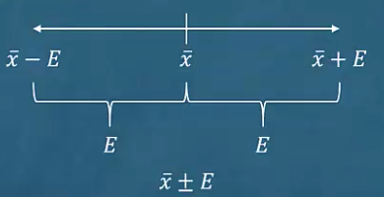
Confidence Interval Estimate
When the population mean is not known we will increase the reliability of our estimate by constructing what is called a confidence interval estimate. That will be centered at the sample mean and surrounded by a margin of error.
We would begin by calculating the sample mean. We would then add the margin of error to the sample mean and then subtract the margin of error from the sample mean.

Slide 6

Formula for Margin of Error
$$E=t_{\frac{α}{2}}\left(\frac{s}{\sqrt{n}}\right)$$
The margin of error when calculating a confidence interval about a single mean is determined by three factors:
t-value
sample standard deviation
sample size

Slide 7
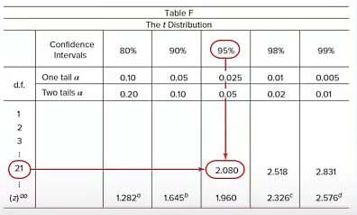
t Value
The t value is taken from a distribution known as the student t distribution.
This table shows an excerpt from a table of t distribution values. Note the abbreviation in the left column d.f. This refers to the number of degrees of freedom.
For this application the number of degrees of freedom is one less than the sample size.

Slide 8
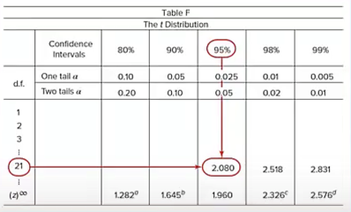
Top of t Distribution Table
Note the top row gives varying confidence levels.
The highlighted example would be for the construction of a 95% confidence interval with 21 degrees of freedom.

Slide 9
Example
Arctic Sea Ice Extent
Sample of 37 days
Mean = 11.9 million sq km
St dev = 0.4 million sq km
Construct a 95% confidence interval estimate for the population mean Arctic Sea Ice Extent.
Assumptions
The sample is a random sample
Either n > 30 or the population is normally distributed when n < 30

Slide 10
Margin of Error
So we will calculate the margin of error and add it to and subtract it from the sample mean. Recall that the calculation of the margin of error requires the use of a value from the t distribution. Our confidence level is to be 95%. The number of degrees of freedom will be one less than the sample size.
d.f. = n - 1 = 37 - 1 = 36
So we will examine the table and look across the top row for our 95% confidence level. This is the column that we will get our t value from. Now we will drop down until we find 36 degrees of freedom and find out where that crosses up with the 95% column and we have a value of 2.028.

Slide 11
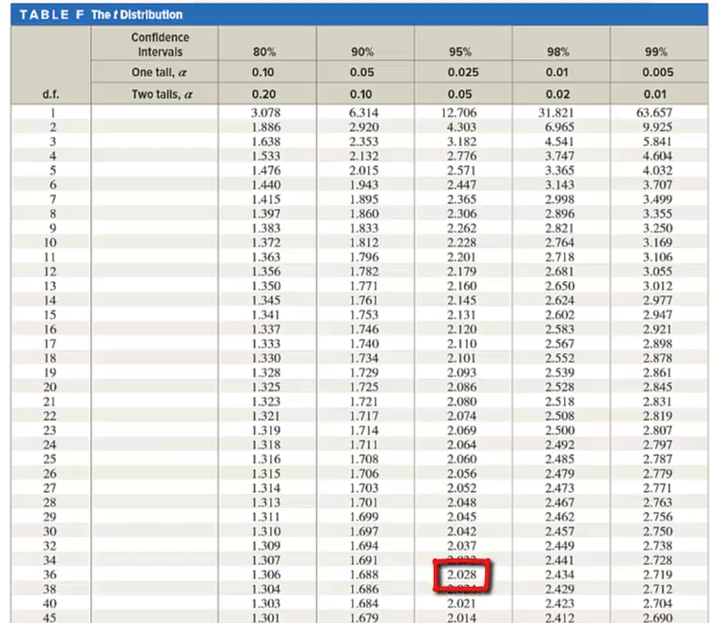
T Distribution

Slide 12

Confidence Interval
We will calculate the left and right end points of our confidence interval by substituting the sample mean t value, sample standard deviation, and sample size.
$$E=t_{\frac{α}{2}}\left(\frac{s}{\sqrt{n}}\right)$$
$11.9−2.028\left(\frac{0.4}{\sqrt{37}}\right)=11.8$ $11.9+2.208\left(\frac{0.4}{\sqrt{37}}\right)=12.0$
It can be stated with 95% confidence that the population mean Arctic Sea Ice Extent is between 11.8 and 12.0 million square kilometers.

Slide 13
Summary
In this PowerPoint, we learned how to construct a confidence interval estimate for the population mean and how to calculate the margin of error for a confidence interval estimate.

